Slide 1
Generating data from text
Data Science Bubble 17/4/2024

Slide 2
Opportunity
Lots of useful information in text
Challenge: there is lots of it and it is high-dimensional
Solution: Latent Dirichlet Allocation (LDA)
Today: Simple application to central bank speeches
What do central bankers talk about?
How has that changed over time?

Slide 3

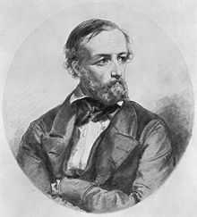
LDA origins

Slide 4
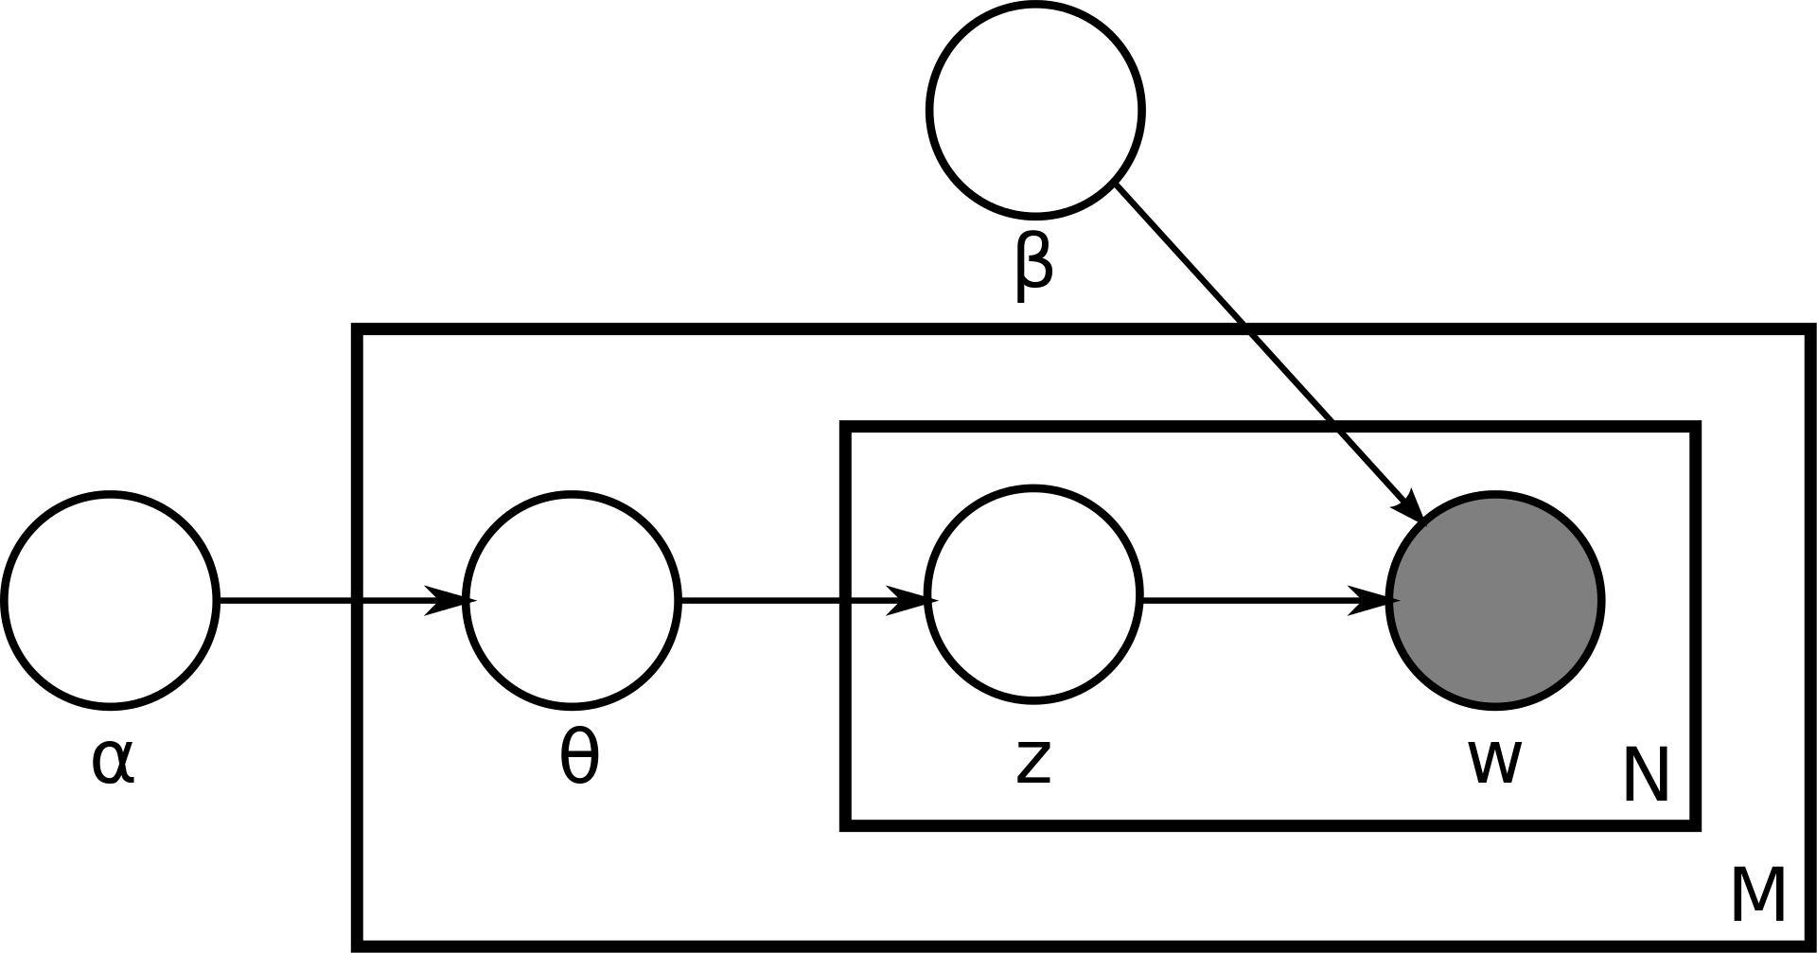
The LDA view of how speech is generated

Slide 5
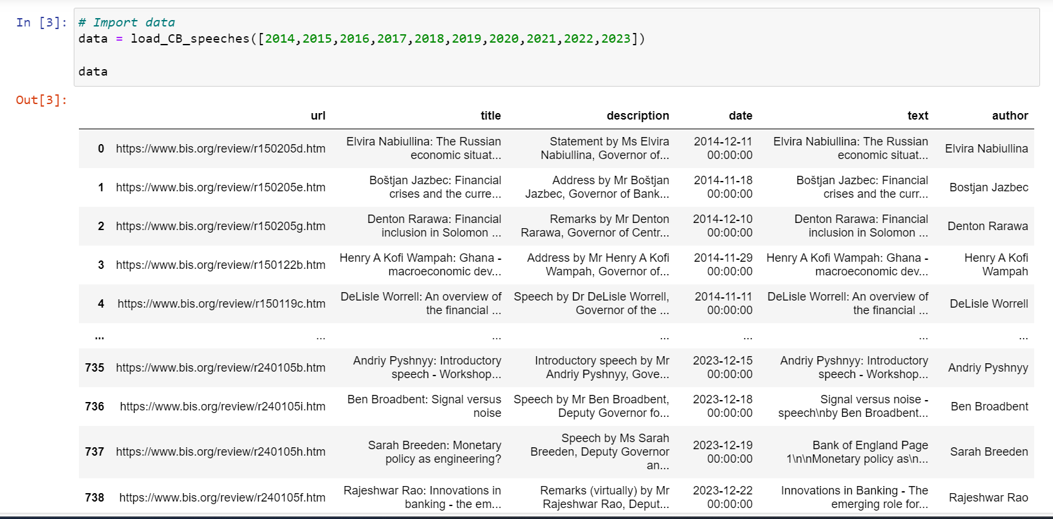
Estimate LDA model for central bank speech from BIS (gingado)

Slide 6
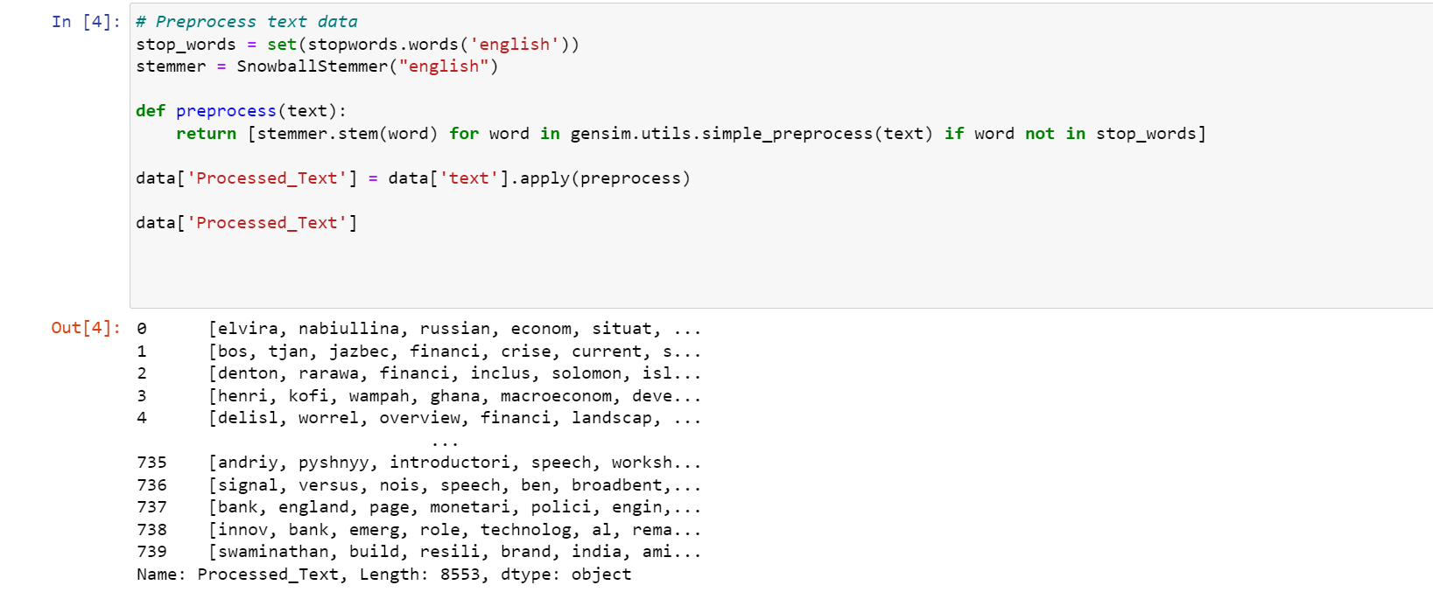
Preprocessing text

Slide 7
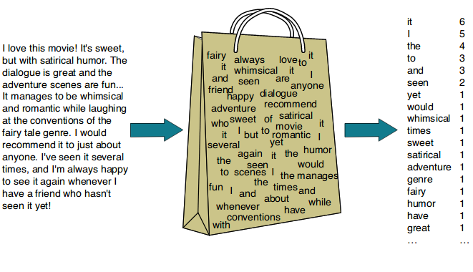
Bag of words

Slide 8
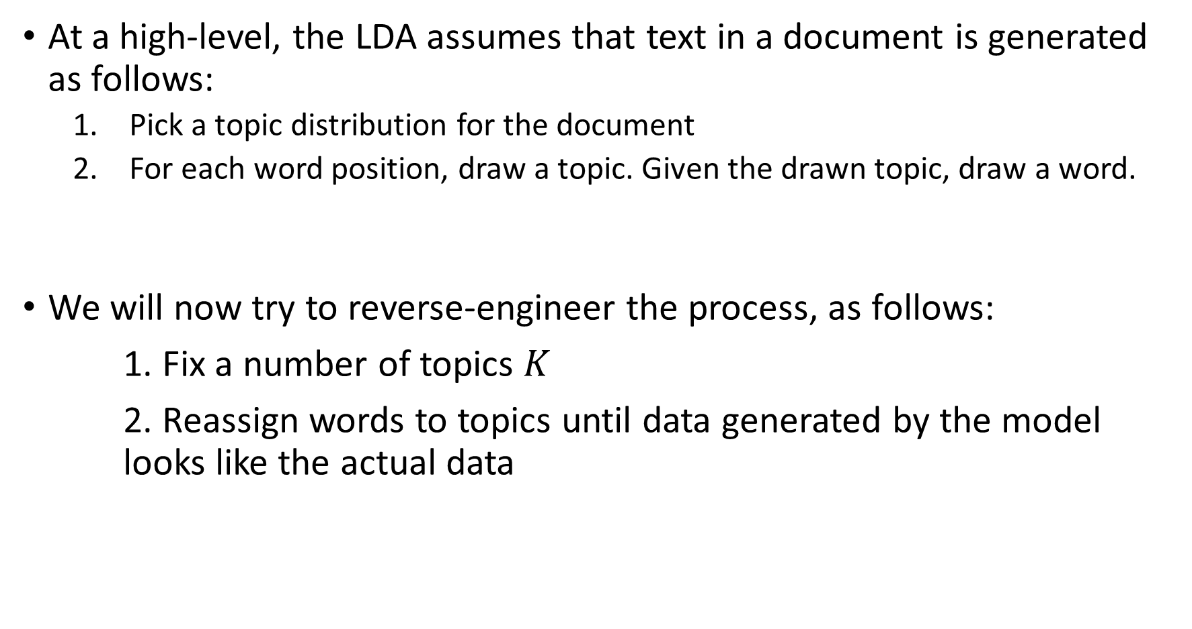
Estimation
At a high-level, the LDA assumes that text in a document is generated as follows:
Pick a topic distribution for the document
For each word position, draw a topic. Given the drawn topic, draw a word.
We will now try to reverse-engineer the process, as follows:
1. Fix a number of topics $K$
2. Reassign words to topics until data generated by the model looks like the actual data

Slide 9
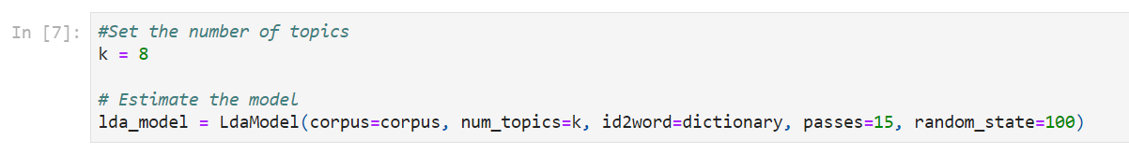
Estimation

Slide 10
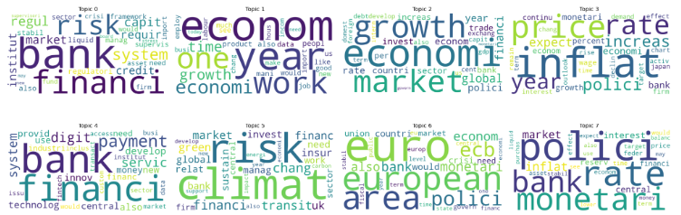
Estimated latent topics

Slide 11
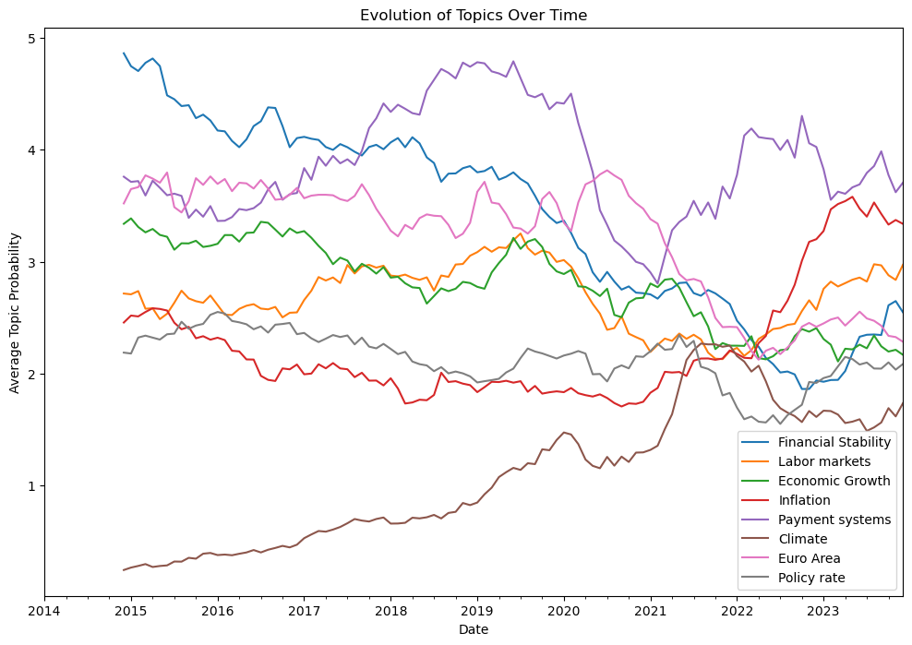
Evolution of topics over time

Slide 12
Notebook to be shared
Python notebook with links
ChatGPT Copilot + Ragnar= 2 hours. Really simple.

